Slide 1
Corner Detection
.
Extraction of High Level Features from Images

Slide 2
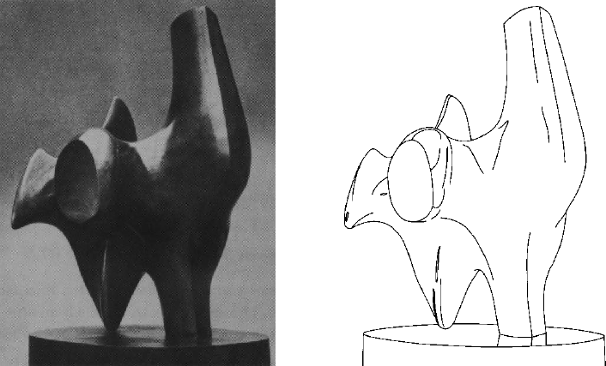
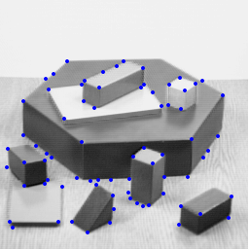
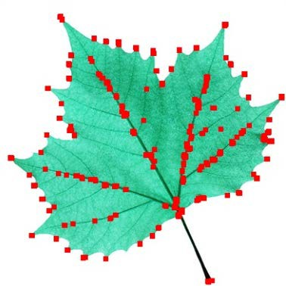
Let’s see some examples first …
Edge Detection
Corner Detection

Slide 3
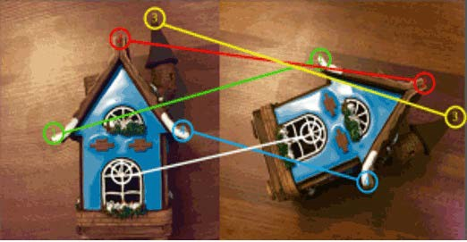

Motivation: Application of Corners
Object Recognition
Matching of Objects using Corners
Image source: https://circuitdigest.com/tutorial/object-detection-using-python-opencv

Slide 4
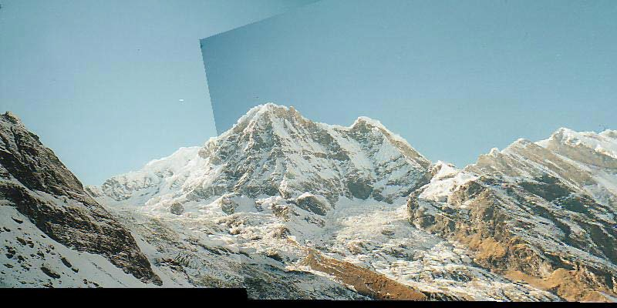
Motivation: Application of Corners
Image registration (image stitching)
Find corresponding pairs
Use these pairs to align images

Slide 5
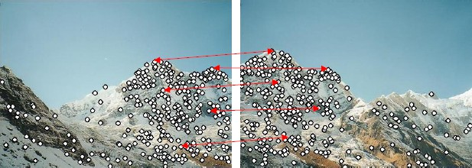
Motivation: Application of Corners …contd
Image registration
– Detect corners and find repeatable points for matching,

Slide 6
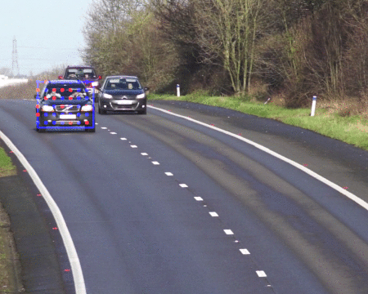

Motivation: Application of Corners
Object Tracking
Tracking using Median Flow
Lucas-Kanade Feature Tracker
Image source: https://summerofhpc.prace-ri.eu/breaking-the-4th-dimensional-wall-of-object-tracking/

Slide 7
Other Applications
3D Reconstruction
Image Stitching
Stereo calibration
Robot navigation
… and many more

Slide 8
Corner Detection
It relates to a broader topic called
Feature-point or Interest-point or Key-point Detection
Other interest point/key point detection methods
SIFT: Scale Invariant Feature Transform
SURF: Speeded-up Robust Feature
HOG: Histogram of Oriented Gradient
… and many more

Slide 9
Edge (feature) in an Image
Collection of continuous pixels with high gradient in a direction.
Edge Detection
Convert a 2D image into a set of curves
Extracts salient features of the scene
More compact than pixels

Slide 10
Corner in an Image
A corner is characterized by (general ideas)
Intersection of two lines
A place of high curvature point
presence of a large variation of gradient in all directions at a point of interest

Slide 11




Why use of Corners, not edges?
Aperture problem
The reason interest point or corner points are good is that it does not have aperture problem
Imagine looking at a scene using SODA STRAW (focusing on edge part)
when looking at very small region, there is ambiguity all the time
If we see whole thing then no ambiguity
However, corner does not face aperture problem
Ambiguity in matching
an edge point
𝒙_{𝒋}
𝒖𝒖
𝒙_{𝒋} + 𝒖
No ambiguity when matching a corner point

Slide 12

Why use of Corners, not edge?
A point on a line is hard to match.
Matching of a point from Object 1 to Object 2
Object 1 Object 2
Matching of corners is easier
Object 1
Object 2

Slide 13
The Harris corner detector
A popular corner detector which works quite well
Proposed in 1988 by researcher called Harris

Slide 14
The Basic Idea
We should easily recognize the corner point by looking through a small window
Shifting a window in any direction should give a large change in intensity (in case of corner)

Slide 15
Harris Detector: Basic Idea
“flat” region:
no change in all directions
“edge”:
no change along the edge direction
“corner”:
significant change in all directions

Slide 16


The Harris Corner Detector
Idea used for Corner Detection:
Exactly at a corner, gradient is ill defined
In the region around a corner, if we analyze the distribution of gradient, we shall find two dominant directions of the gradient change
𝑰_{𝒚}
𝑰_{𝒚} 𝑰_{𝒚}
****
****
*
****
***
****
****
𝑰
𝒙
𝑰
𝑰
𝒙
𝒙
****
No edge
One edge
Corner

Slide 17
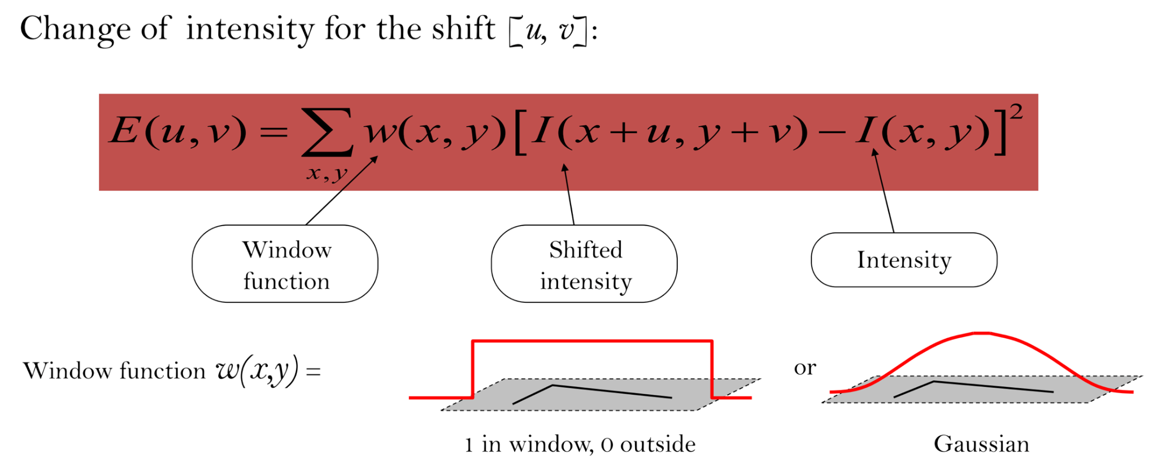
Harris Detector: Mathematics

Slide 18
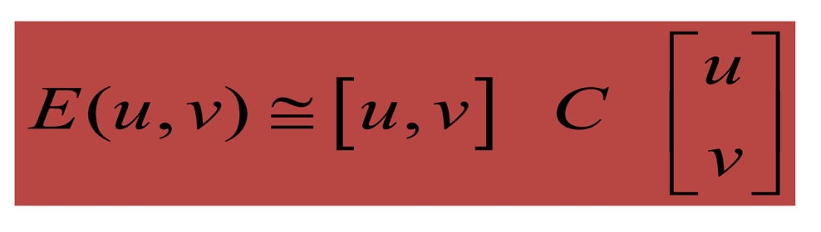
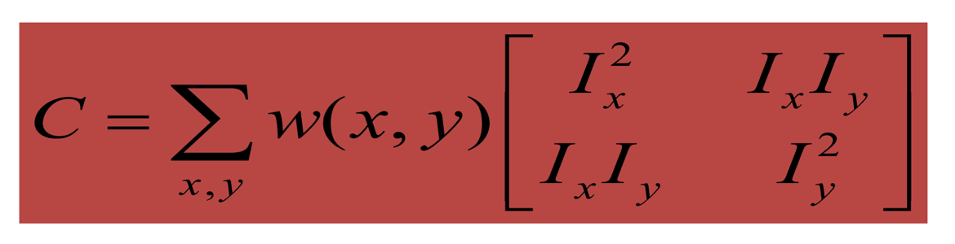
Harris Detector: Mathematics
For small shifts [u,v], we can approximate E(u,v) using a Taylor expansion
where C is a 2×2 matrix computed from image derivatives:

Slide 19
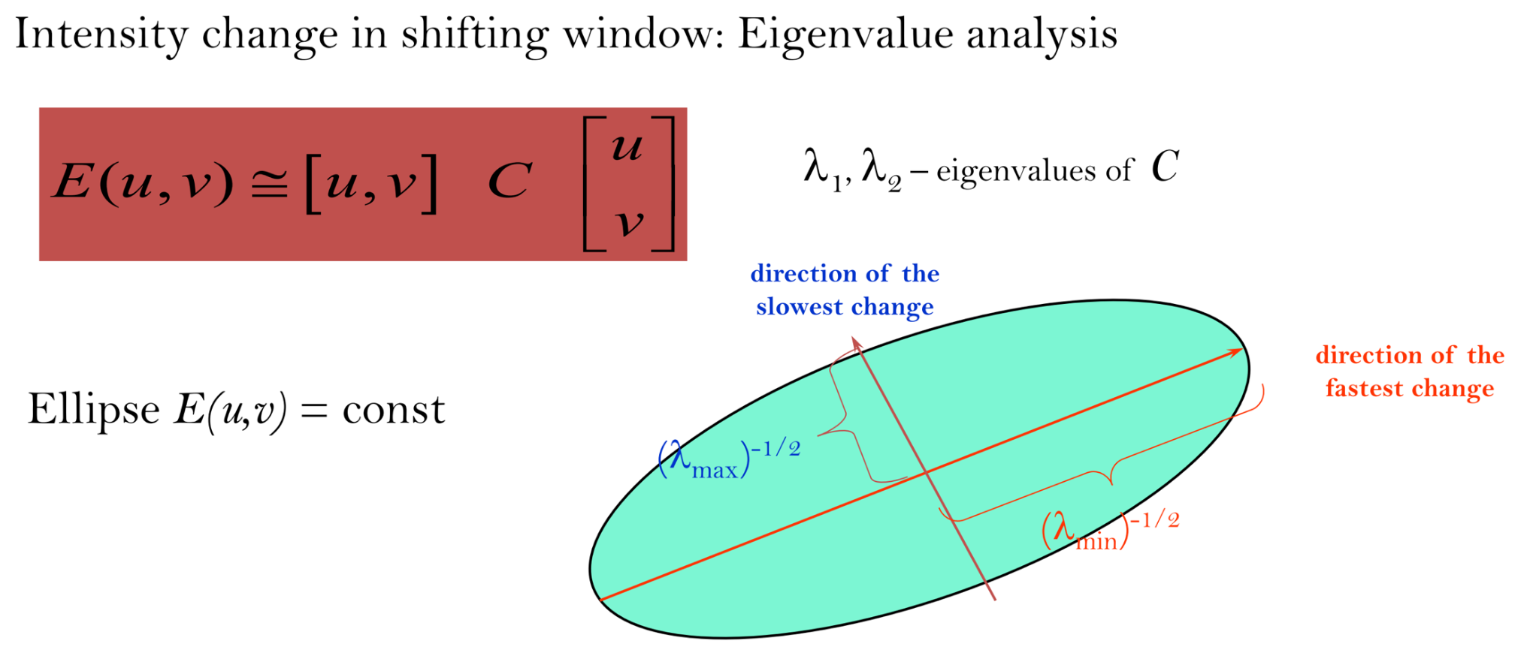
Harris Detector: Mathematics

Slide 20
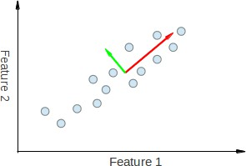
The Harris Corner Detector – An alternate explanation
Use of Eigen analysis
– Also known as Principal Component Analysis (PCA)
λ₁ > λ₂
Red vector: for ^{Eigenvalue λ}1 Green vector: for ^{Eigenvalue λ}2
Image source: https://docs.opencv.org/3.4/d1/dee/tutorial_introduction_to_pca.html

Slide 21
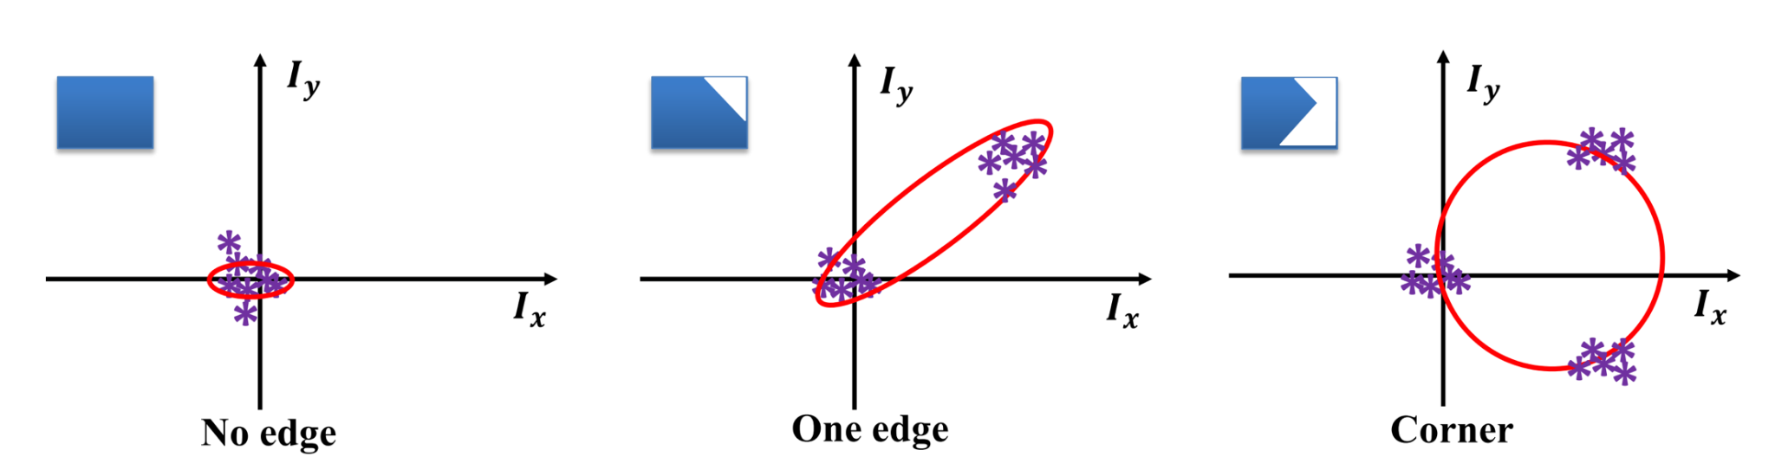
The Harris Corner Detector – An alternate explanation
Use of Eigen analysis
– Also known as Principal Component Analysis (PCA)

Slide 22
The Harris Corner Detector – An alternate explanation
Use of Eigen analysis
Presence of large variation of gradient in all directions can be analyzed using Eigen-analysis
Matrix C should have two large Eigen values at the point of interest for it to be a corner or a key-point
Based on the magnitude of Eigen values, key-point can be detected
Eigen-value decomposition for symmetric matrix
C=X⁻¹ ∑ X
∑ - contains Eigen-values and X - contains Eigen vectors

Slide 23
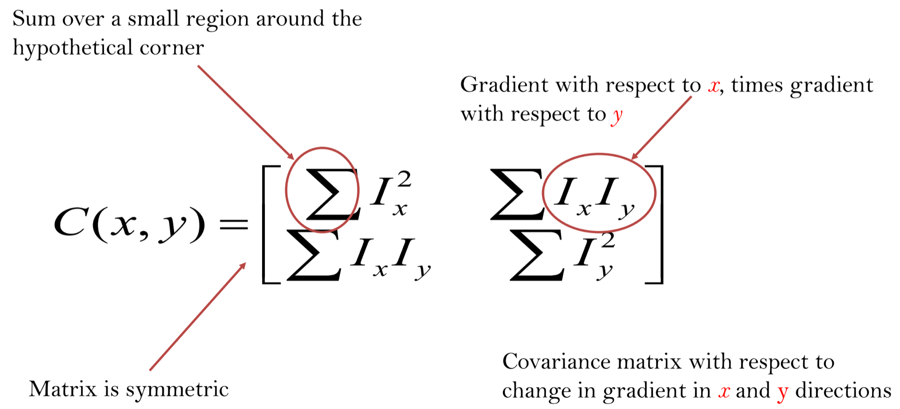
The Harris Corner Detector

Slide 24
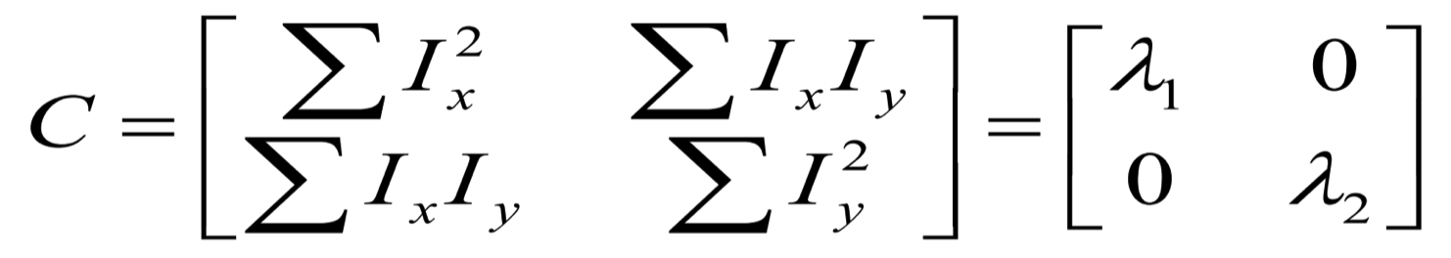


The Harris Corner Detector
First, consider Simple Case where:
This means dominant gradient directions align with x or y axis
If either λ is close to 0, then this is not a corner, so look for locations where both are large
Corner point
Window for corner detection,
There is no point in this window where both Ix and Iy exist together, so Ix × Iy = 0

Slide 25
The Harris Corner Detector
What is the region look like if:
Only λ₁ = 0? (Edge)
Only λ₂ = 0? (Edge)
3. λ₁ = 0
4. λ₁ > 0
and λ₂ = 0? (Interior region) and λ₂ > 0? (Corner point)

Slide 26







The Harris Corner Detector
Edge
𝝀_{𝟐} ≫ 𝝀_{𝟏}
Corner
𝝀_{𝟏} 𝐚nd 𝝀_{𝟐} are large
𝝀_{𝟐}
Interior
𝝀_{𝟏} ≈ 𝟎
𝝀_{𝟐} ≈ 𝟎
Edge
𝝀_{𝟏} ≫ 𝝀_{𝟐}
𝝀_{𝟏}

Slide 27

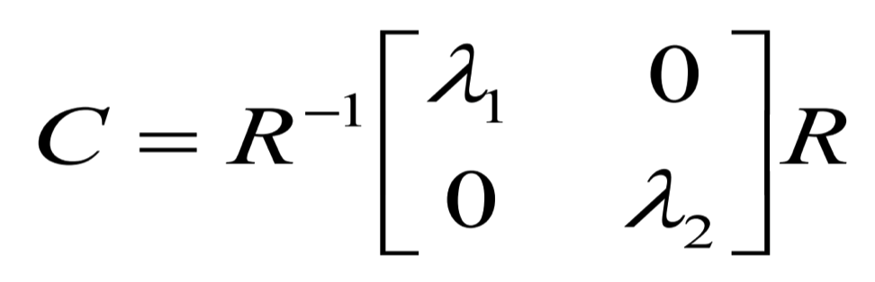


The Harris Corner Detector
Now, consider a General Case
In a general case, it can be shown that since C is symmetric, it can be written as follows (R is a rotation matrix):
Corner point
So every case is like a rotated version of the one discussed earlier.

Slide 28
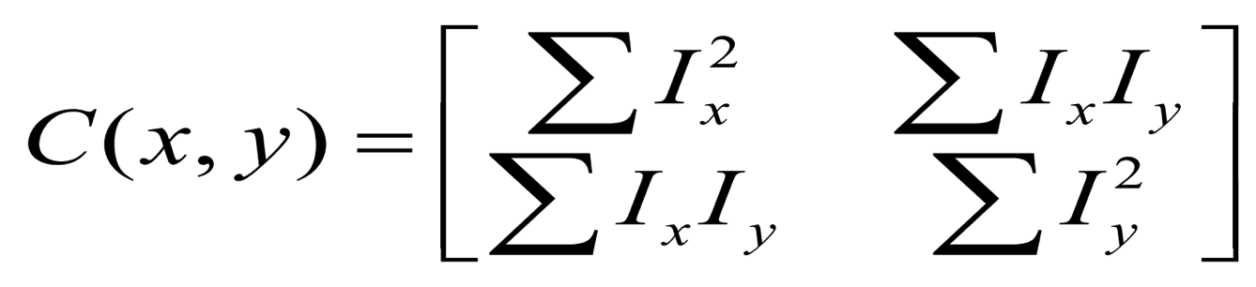
Corner Detection - Steps
Filter image with Gaussian to reduce noise
Compute magnitude of the x and y gradients at each pixel
I_{x} and I_{y}
Construct matrix C in a window around each pixel (x, y)
Harris uses a Gaussian window – just blur

Slide 29
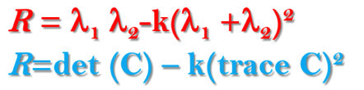
Corner Detection - Steps
Computation of λ’s :
– Solve for product of λ’s (determinant of C)
If λ’s are both big (i.e. product reaches local maximum & is above threshold), we have a corner
Harris also checks that ratio of λ’s is not too high
Harris Response Calculator
where k is an empirically determined constant; k lies in [0.04, 0.06]
Non-maximum Suppression
– In order to pick up the optimal values to indicate corners, we find the local maxima as corners within the window which is a 3 by 3 filter.

Slide 30
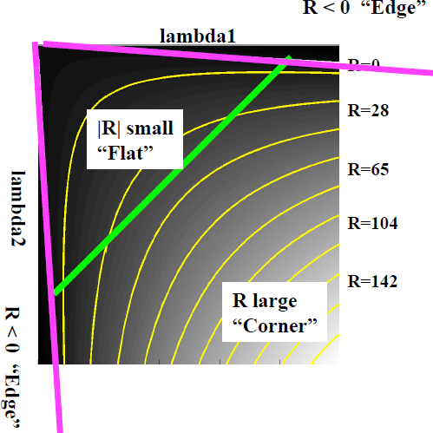







Harris Corner Response Map
“Edge”
𝑹 < 𝟎
“Corner”
𝑹 > 𝟎
“Flat”
|𝑹| small
“Edge”
𝑹 < 𝟎
Image source: http://www.cse.psu.edu/~rtc12/CSE486/lecture06.pdf

Slide 31
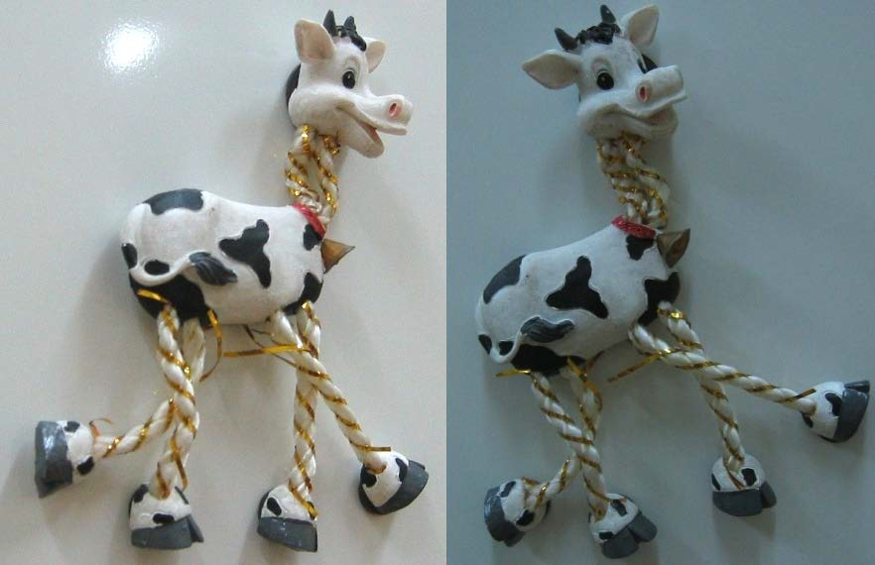
Harris Detector: Workflow

Slide 32
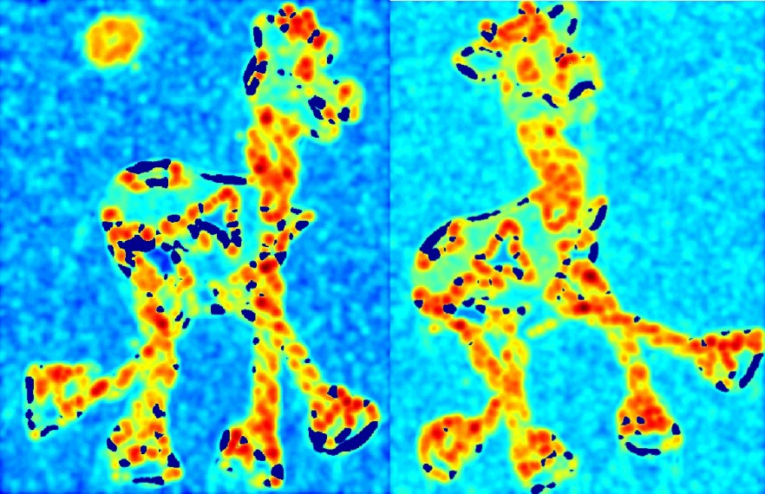



Harris Detector: Workflow
Compute corner response R

Slide 33
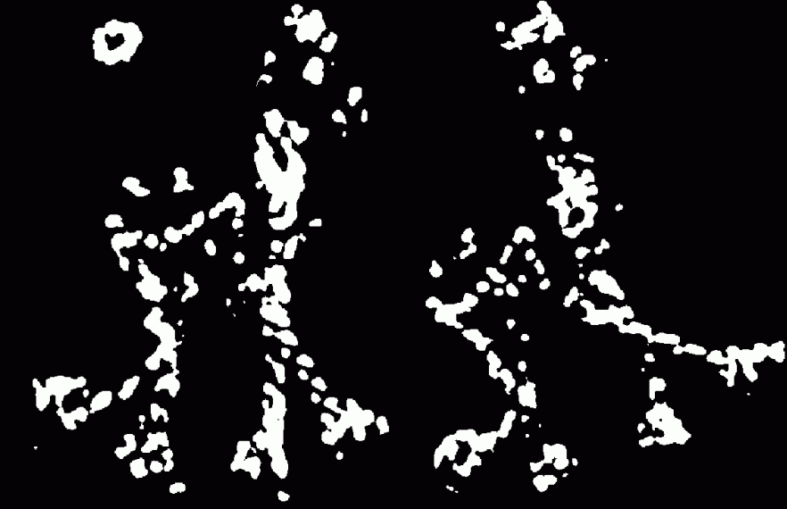
Harris Detector: Workflow
Find points with large corner response: R>threshold

Slide 34
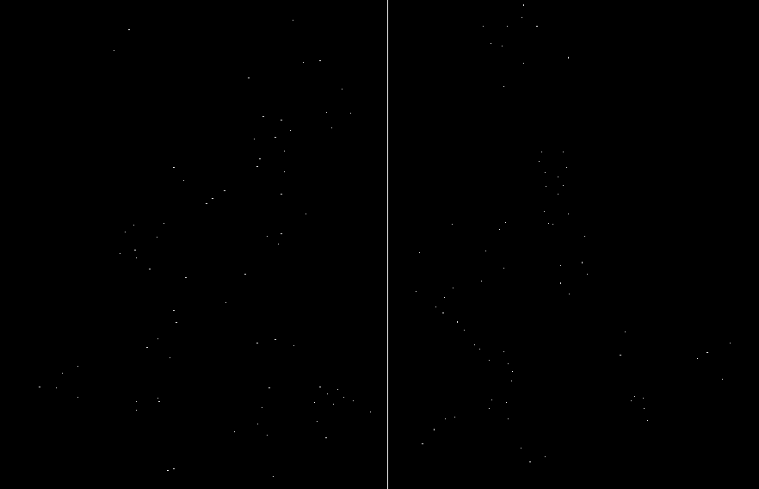
Harris Detector: Workflow
Take only the points of local maxima of R

Slide 35
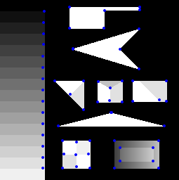
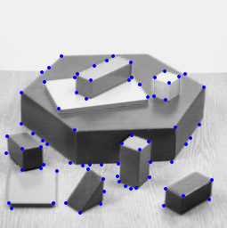
Image with Detected Corners

Slide 36
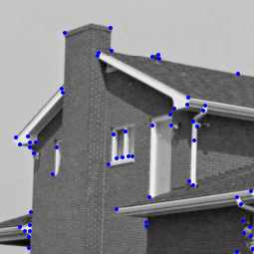
Image with Detected Corners

Slide 37
Example- Harris Corners
Originally developed as features for motion tracking
Greatly reduces amount of computation compared to tracking every pixel
Translation and rotation invariant (but not scale invariant)

Slide 38
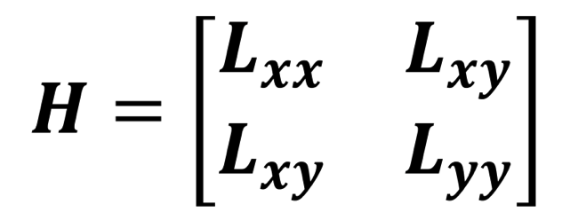
Hessian Matrix based Key-Point Detection
Detection of salient feature points (key-points) in the image using hessian matrix
Use of Hessian matrix for key-point detection
Hessian Matrix
Key point is detected where determinant (H) is large

Slide 39
End

